Slide 1
Machine Learning HW12
ML TAs
mlta-2023-spring@googlegroups.com

Slide 2
HW Content
In this HomeWork, you can implement some Deep Reinforcement Learning methods by yourself：
Policy Gradient
Actor-Critic ( Implement by yourself to get high score !)
The environment of this HW is Lunar Lander in gym of OpenAI.
Other details can be found in the sample code.

Slide 3
Illustraion

Slide 4
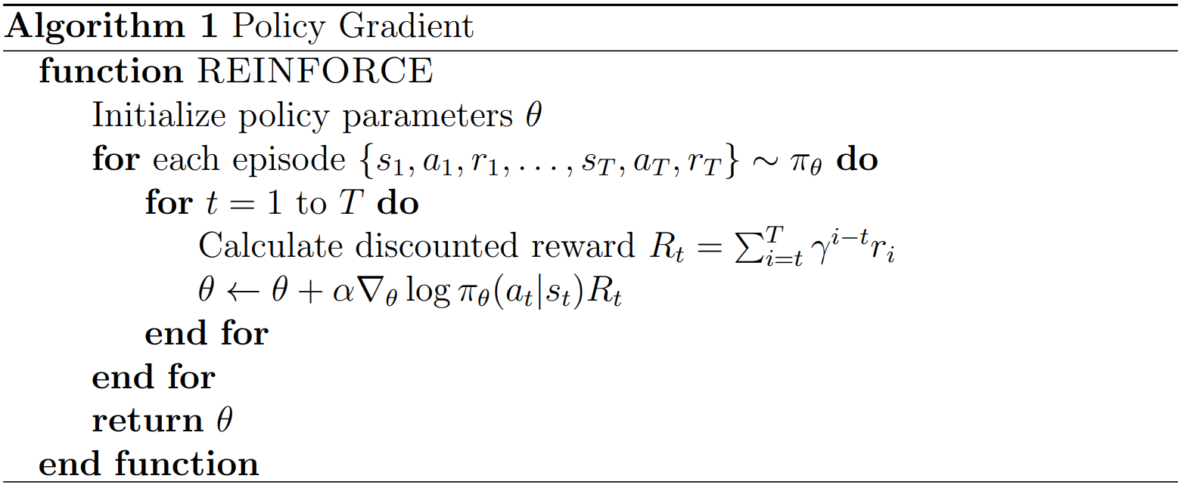
Policy Gradient(to get 3 points)

Slide 5
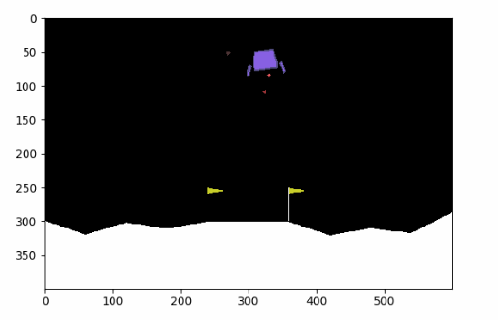
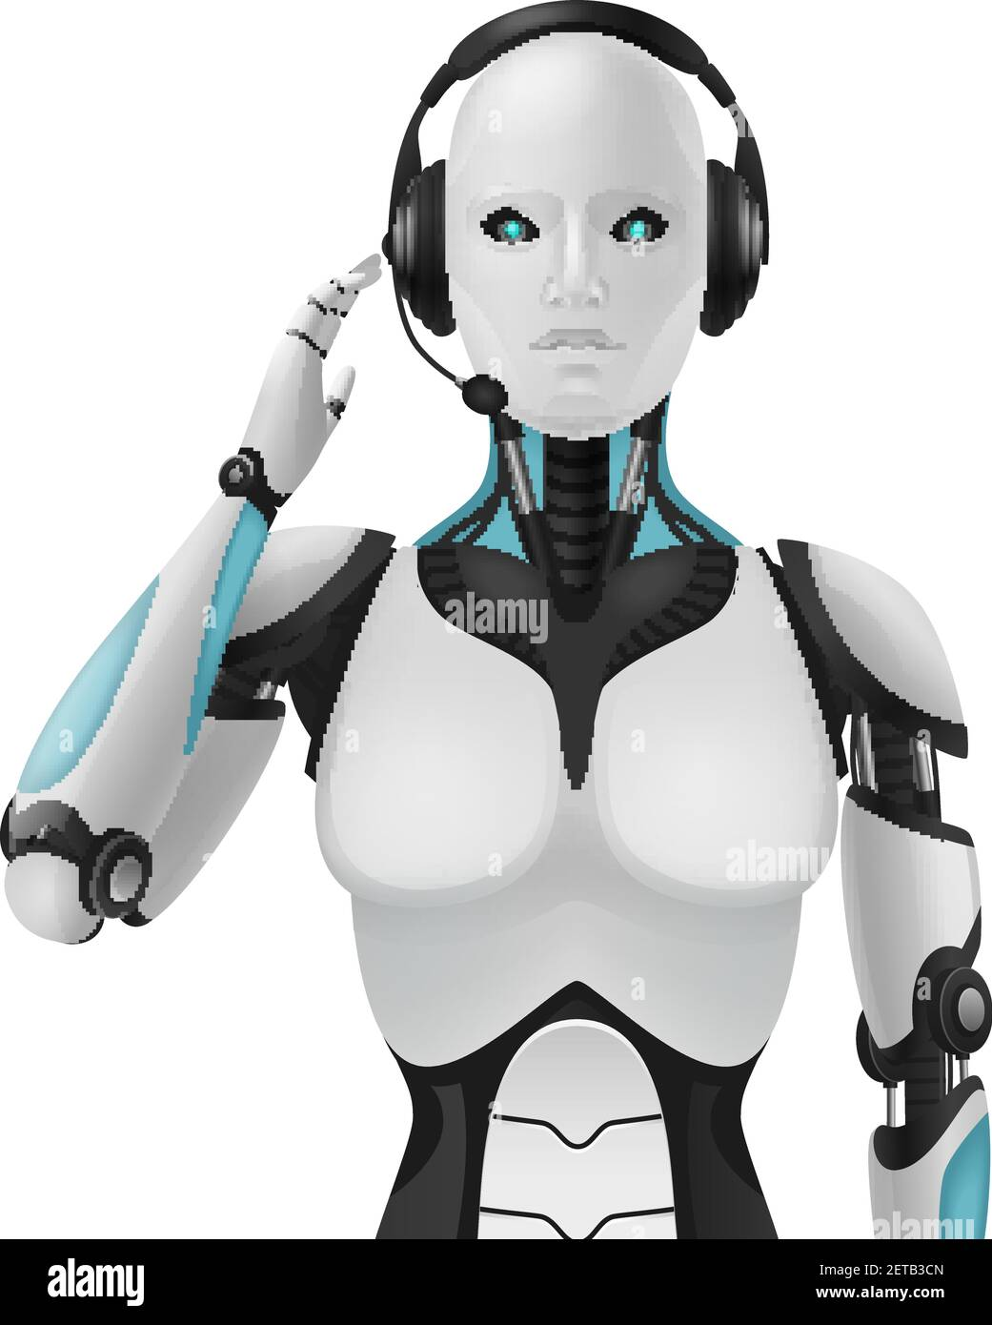
Agent
state
action
reward

Slide 6
Policy Gradient(to get 3 points)
Ƴ = 0.99, t=1, T = 3
R1 = r1 + 0.99 * r2 + 0.99^2 * r3
R2 = r2 + 0.99* r3
R3 = r3

Slide 7
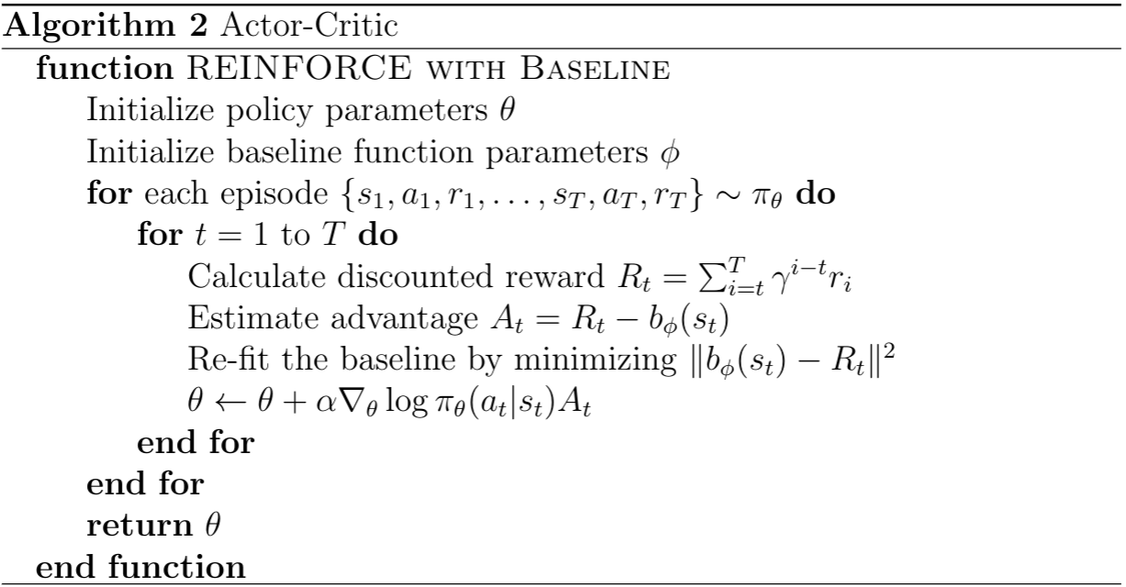
Actor-Critic(to get 4 points)

Slide 8
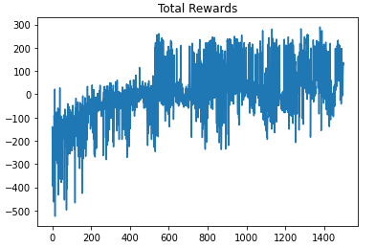
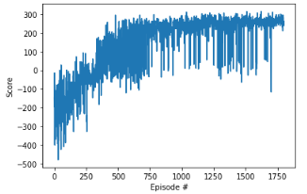
Sample Result

Slide 9
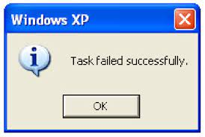
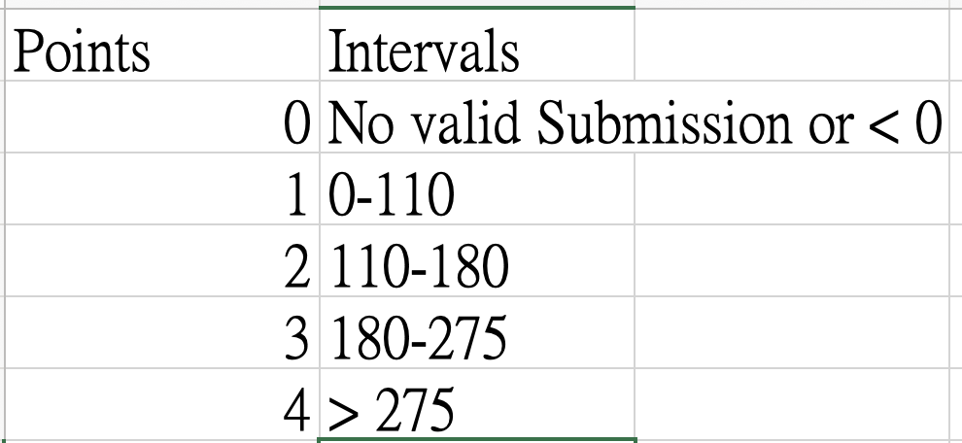
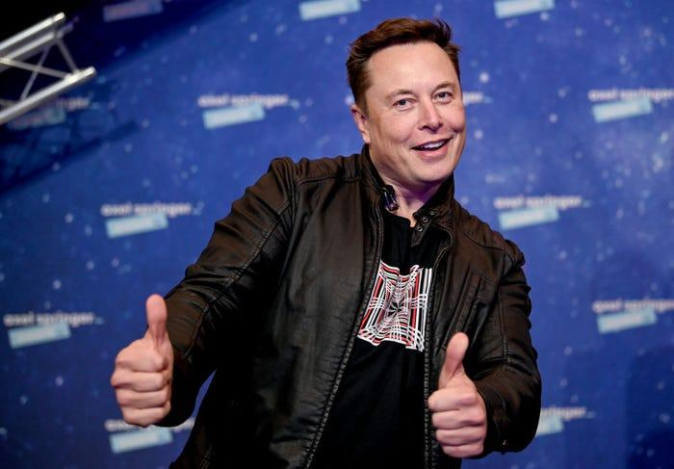
What you need to submit & Grading
Python file ( 2 points) ( Submit on NTU COOL)
Action List (4 points) (On JudgeBoi, no private set, the highest one is automatically selected)
Report (4 points) (The questions are on gradescope)

Slide 10
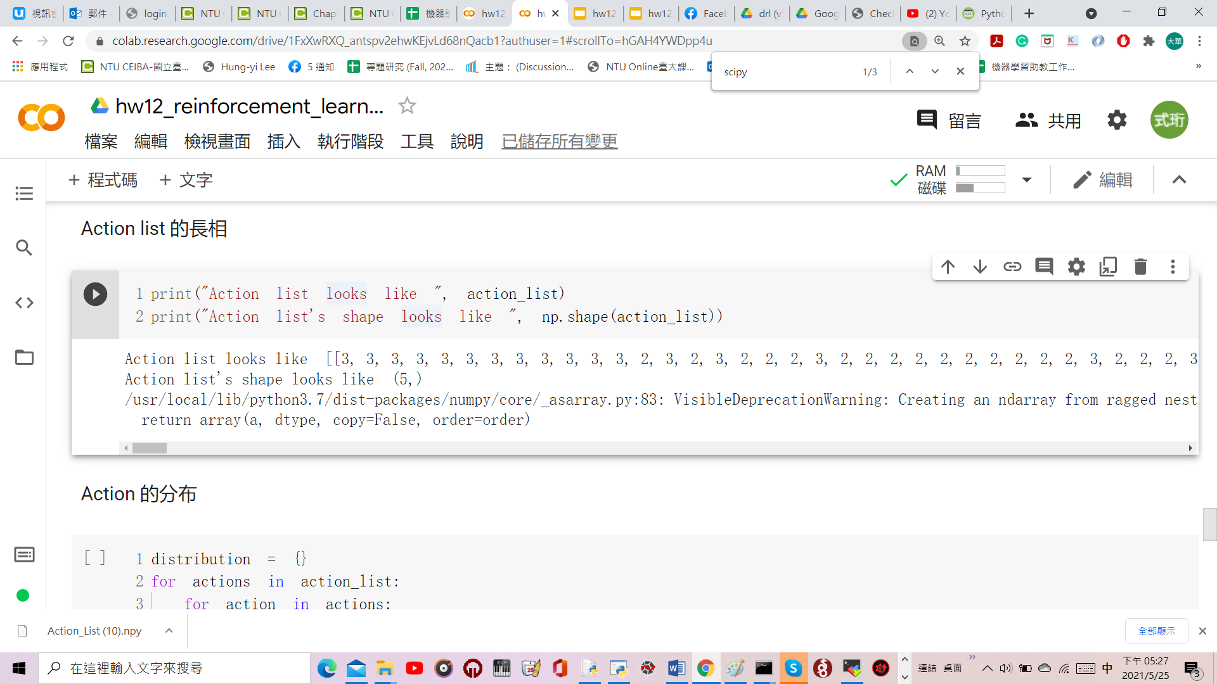
What you need to submit & Grading
More on a "valid submission “:
Your agent should output done after the last input of your action list, action list with mismatched length will be rejected。

Slide 11
Submission & Grading - JudgeBoi Rules (1/2)
We do limit the number of connections and request rate for each IP.
If you cannot access the website temporarily, please wait a moment.
The system can be very busy as the deadline approaches.
If this prevents uploads, we do not offer additional submission opportunities.
Please do not attempt to attack JudgeBoi.
Every Saturday from 6:00 to 9:00 is our system maintenance time.
For any JudgeBoi issues, please post on NTUCOOL discussion.
Discussion Link: https://cool.ntu.edu.tw/courses/24108/discussion_topics/182915

Slide 12
Submission & Grading - JudgeBoi Rules (2/2)
5 submission quota per day, reset at midnight.
Guest users have no quota.
Only *.npy file is allowed, file size should be smaller than 2MB.
You do not have to select submission since there is no private score
JudgeBoi should complete the evaluation within one minute.
You do not need to wait for the progress bar to finish

Slide 13
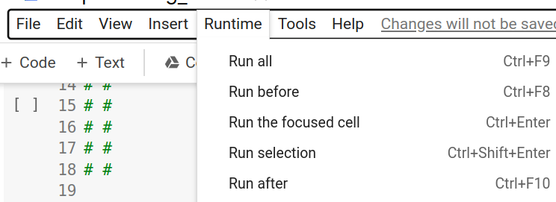
If you can’t reproduce your result on JudgeBoi
Please use “Run all” in colab to avoid reproducibility issues

Slide 14
Note
HW12 won’t use GPU by default.
We recommend to use Colab in HW12.
If anyone intend to use environments other than Colab, please fix reproducibility issues by yourself. TA won’t help you to fix any environment issue.
The training of HW12 should be able to finish within 30 min.

Slide 15
Submission & Grading - Report
(2分) Implement Advanced RL algorithm
Choose one algorithm from Actor-Critic、REINFORCE with baseline、Q Actor-Critic、A2C, A3C or other advance RL algorithms and implement it.
Please explain the difference between your implementation and Policy Gradient
Please describe your implementation explicitly (If TAs can’t understand your description, we will check your code directly.

Slide 16
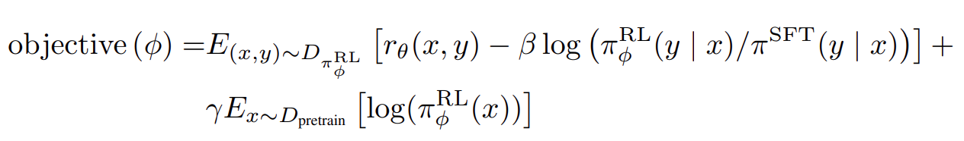
Submission & Grading - Report
2. (2分) How does the objective function of "PPO-ptx" differ from the “PPO” during RL training as used in the InstructGPT paper? (1 point) Also, what is the potential advantage of using "PPO-ptx" over “PPO” in the InstructGPT paper? Please provide a detailed analysis from their respective objective functions. (1 point)
Note. You should answer based on InstructGPT paper

Slide 17
Submission & Grading - NTU COOL
Compress the code, and submit to NTU COOL, the format is show below
Ex: <student_id>_hw12.zip
Only submit the code you use, do not submit other files (model ,data…)
Deadline: 2023/6/16 23:59

Slide 18
Regulations
You should NOT plagiarize, if you use any other resource, you should cite it in the reference.(*)
You should NOT modify your prediction files manually.
Do NOT share codes or prediction files with any living creatures.
Do NOT use any approaches to submit your results more than 5 times a day. Do NOT use pre-trained models.
Your assignment will not be graded and your final grade x 0.9 if you violate any of the above rules.
Prof. Lee & TAs preserve the rights to change the rules & grades.
(*) Academic Ethics Guidelines for Researchers by the Ministry of Science and Technology (MOST)

Slide 19
Deadline
Leaderboard: JudgeBoi
2023/06/16 23:59 (UTC+8)
Code submission: NTU COOL
2023/06/16 23:59 (UTC+8)
Report submission: Gradescope
2023/06/16 23:59 (UTC+8)
Notes:
待確認Deadline

Slide 20
Contact us if you have problems…
NTU COOL (Best way)
link
Email
mlta-2023-spring@googlegroups.com
The title should begin with “[hw12]”
Submit Deadline: 2023/6/16 23:59

